Slide 1
Chapter 20 SOURCE OF MAGNETIC FIELD
20.1 Magnetic Field of a Moving Charge
20.2 Magnetic Field of a Current Element
20.3 Magnetic Field of a Straight Current-Carrying Conductor
20.4 Force Between Parallel Conductors
20.5 Magnetic Field of a Circular Current Loop
20.6 Ampere’s Law
20.7 Applications of Ampere’s Law
20.8 Magnetic Materials

Slide 2
Goals for chapter 20
To determine the magnetic field produced by a moving charge
To study the magnetic field of an element of a current-carrying conductor
To calculate the magnetic field of a long, straight, current-carrying conductor
To study the magnetic force between current-carrying wires
To determine the magnetic field of a circular loop
To use Ampere’s Law to calculate magnetic fields

Slide 3
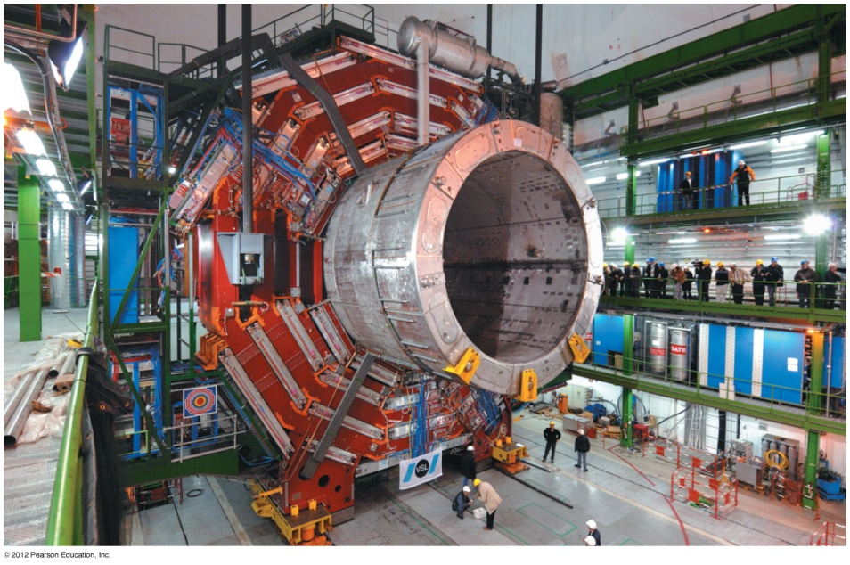
Introduction
What can we say about the magnetic field due to a solenoid?
What actually creates magnetic fields?
We will introduce Ampere’s law to calculate magnetic fields.

Slide 4
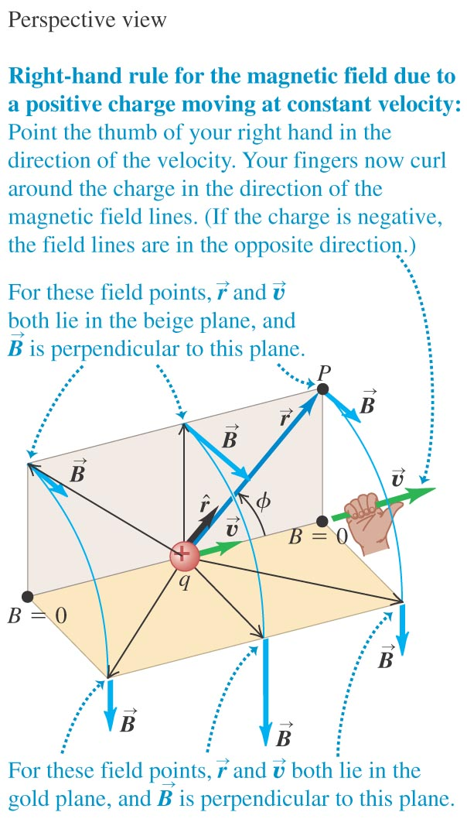
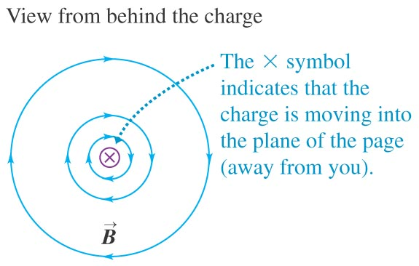
The magnetic field of a moving charge
A moving charge generates a magnetic field that depends on the velocity of the charge.
Figure shows the direction of the field.

Slide 5

20.1 Magnetic field of a moving charge
The magnetic field of a moving point charge is:

Slide 6
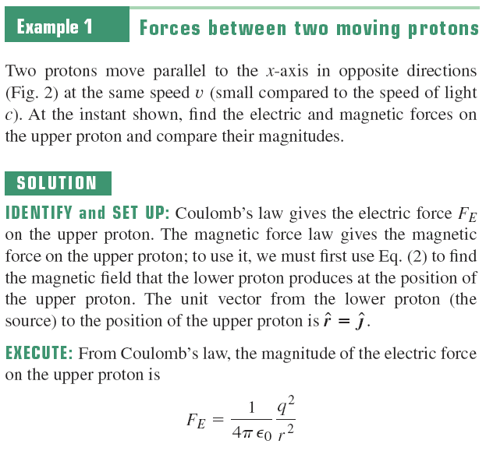
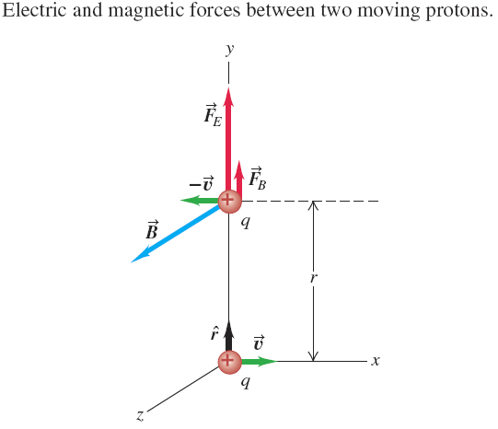

Slide 7
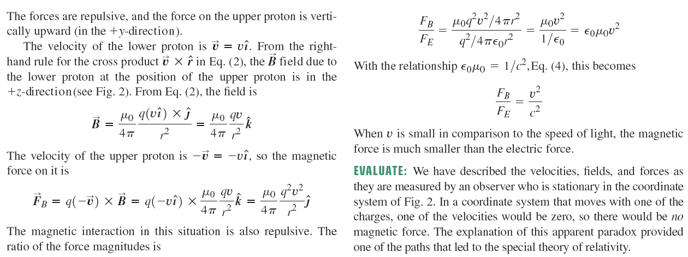

Slide 8
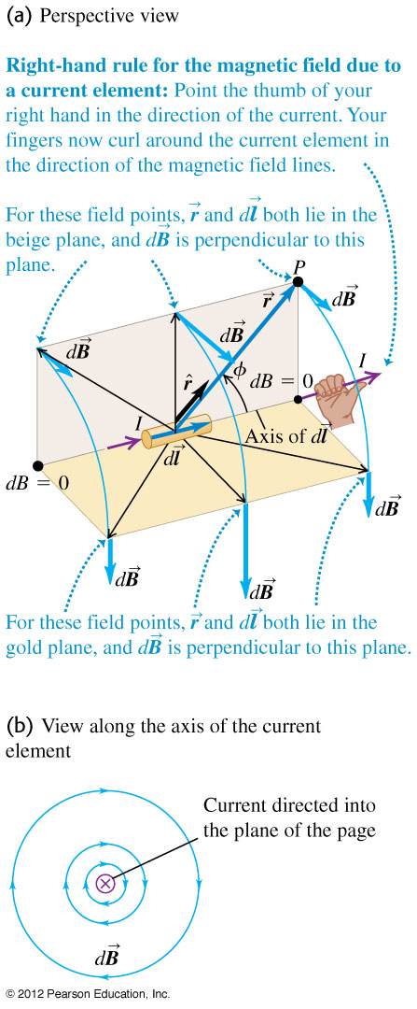
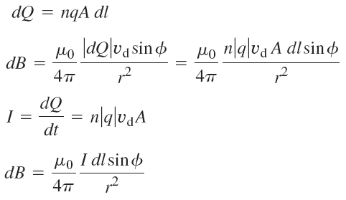
20.2 Magnetic field of a current element
The total magnetic field of several moving charges is the vector sum of each field.
Follow the text discussion of the vector magnetic field due to a current element.
The formula derived is called the law of Biot and Savart.

Slide 9


Magnetic field of a current element
The formula derived is called the law of Biot and Savart.

Slide 10
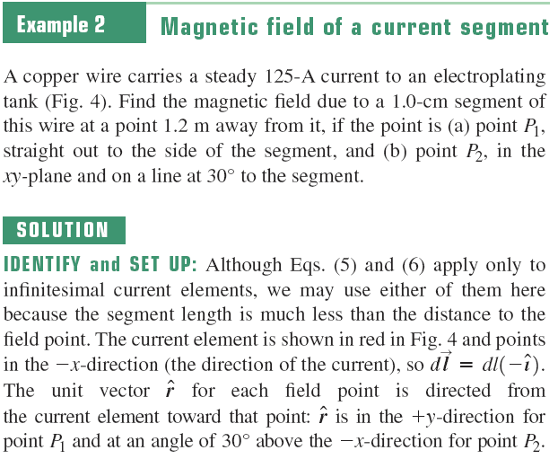
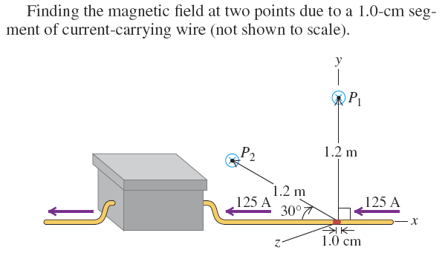

Slide 11
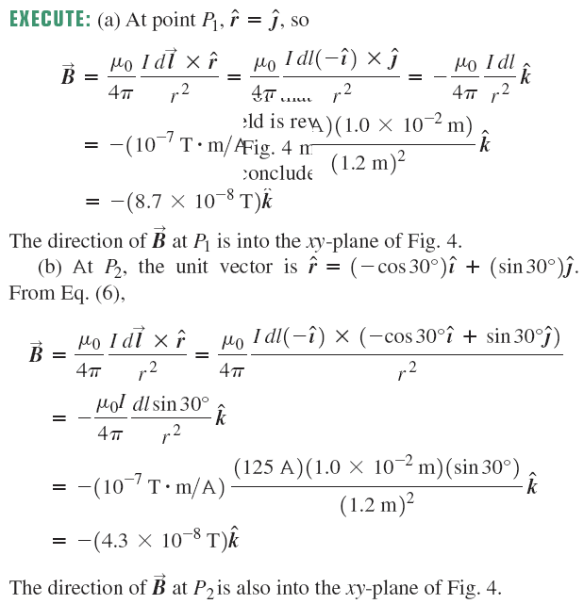
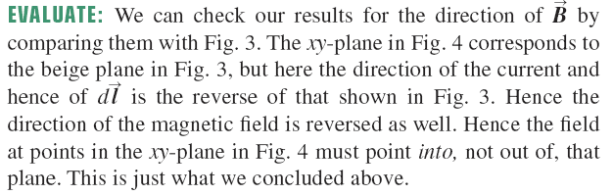

Slide 12

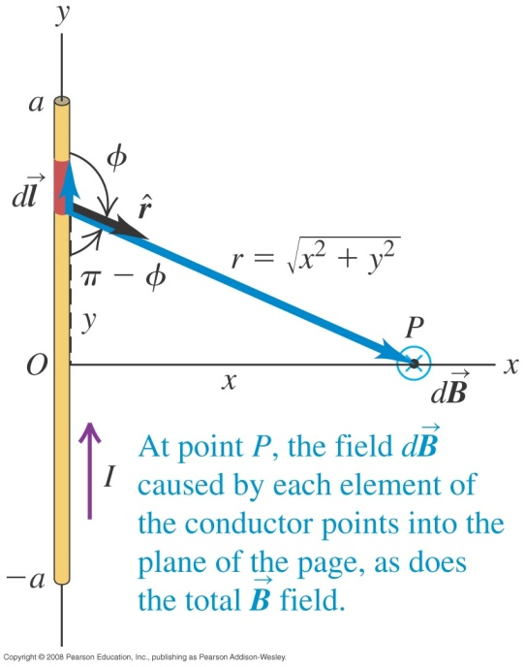
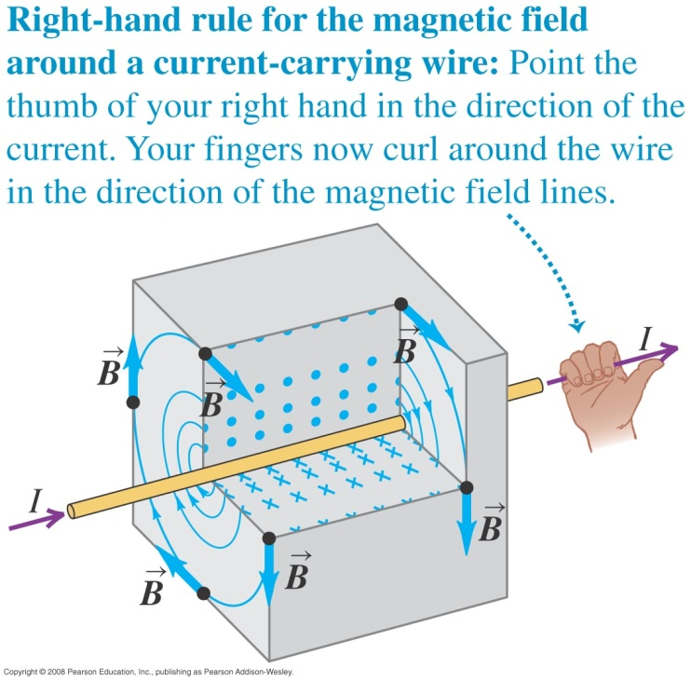
Magnetic field of a straight current-carrying conductor
If we apply the law of Biot and Savart to a long straight conductor, the result is B = μ₀I/2πx. See Figure below left. Figure below right shows the right-hand rule for the direction of the force.

Slide 13
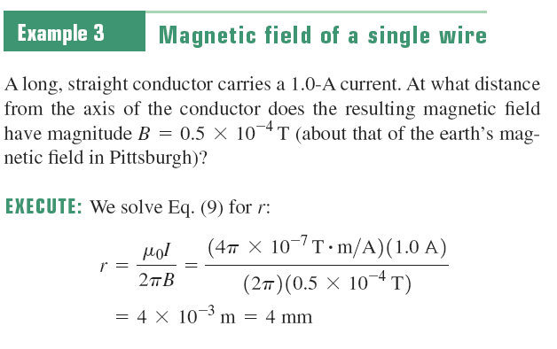
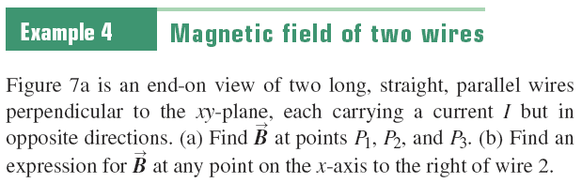


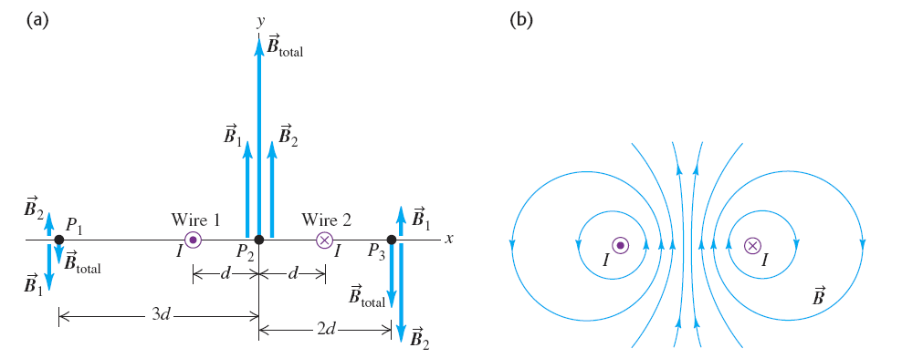


Slide 14
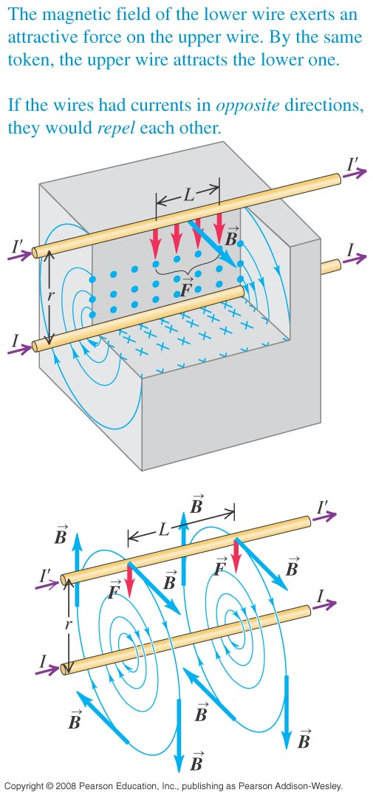
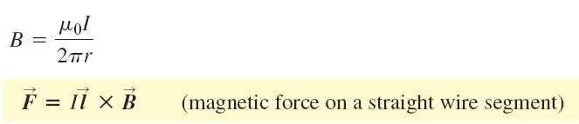
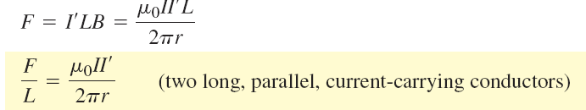
Force between parallel conductors
The force per unit length on each conductor is
The conductors attract each other if the currents are in the same direction and repel if they are in opposite directions.

Slide 15
Magnetic forces and defining the ampere
One ampere is that unvarying current that, if present in each of two parallel conductors of infinite length and one meter apart in empty space, causes each conductor to experience a force of exactly 2*10⁻⁷ newtons per meter of length.

Slide 16
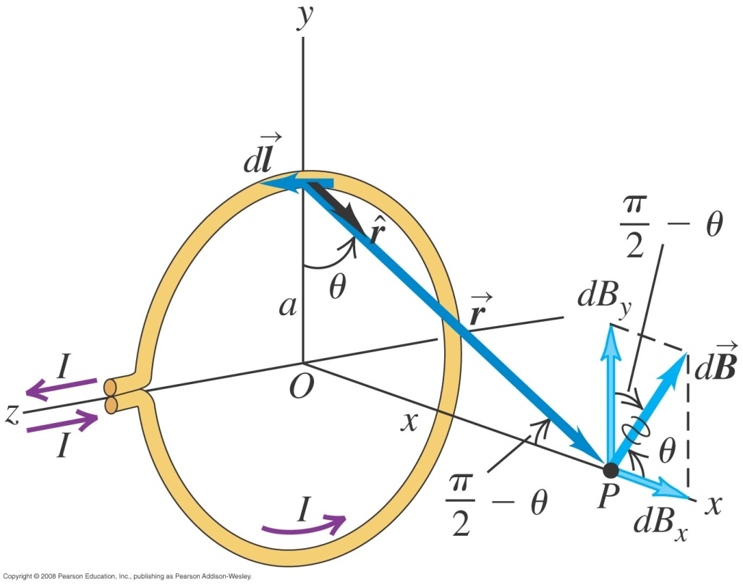

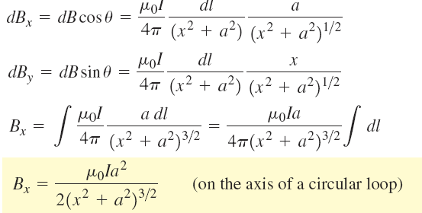
Magnetic field of a circular current loop
The magnitude dB of the field due to the element dl is:
The component of the vector dB are:

Slide 17


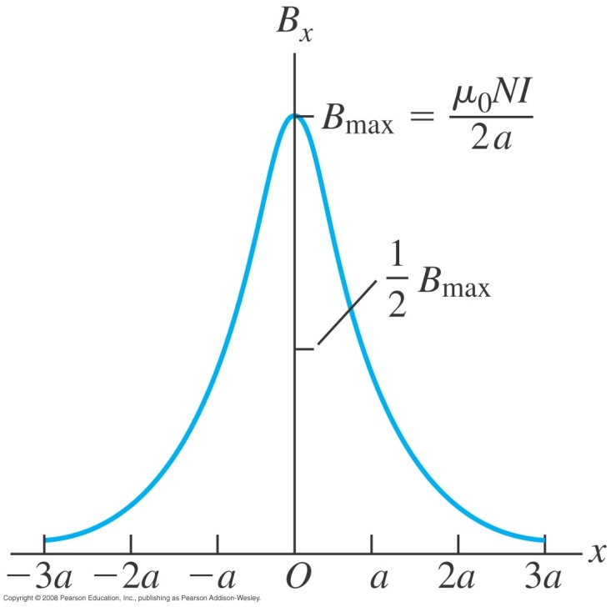
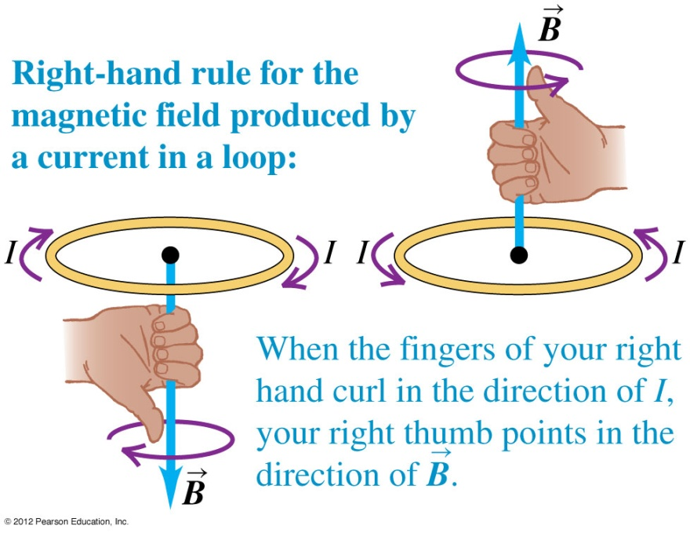
Magnetic field of a coil
The total field is N times field of a single loop:
The maximum value of the field is at x=0, the center of the loop or coil:

Slide 18

Magnetic dipole moment
We define the magnetic dipole moment of a current-carrying loop to be equal to IA, where A is the cross section area of the loop. If there are N loops, the total magnetic moment is NIA.

Slide 19

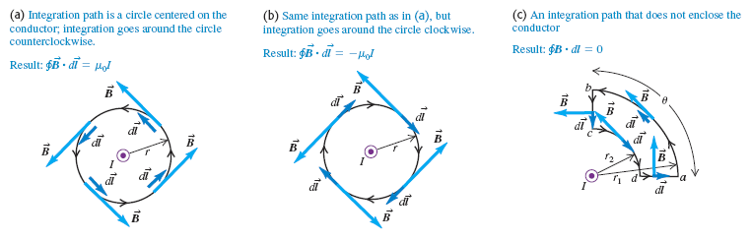
Ampere’s law (special case)
Ampere’s law is formulated not in terms of magnetic flux, but rather in terms of the line integral of B around a closed path, denoted by:

Slide 20

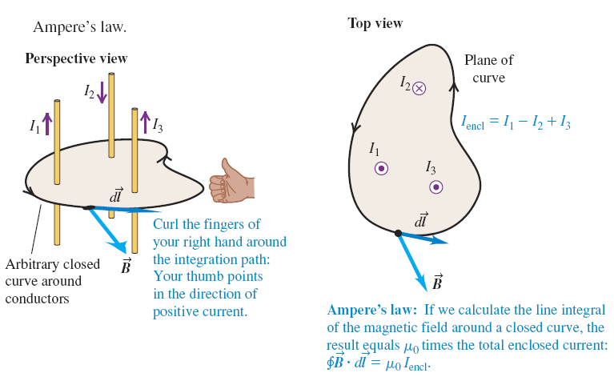
Ampere’s law (general statement)
Our statement of Ampere’s law is then:

Slide 21
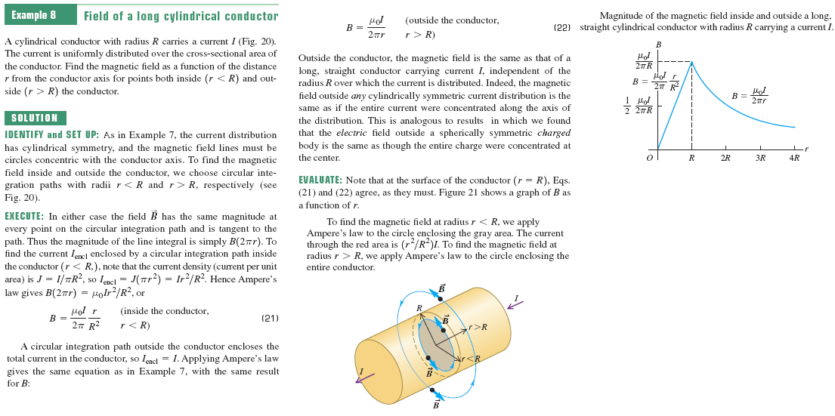

Slide 22
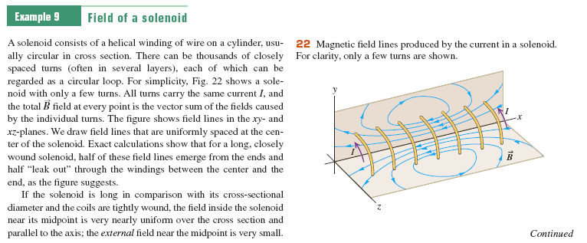

Slide 23
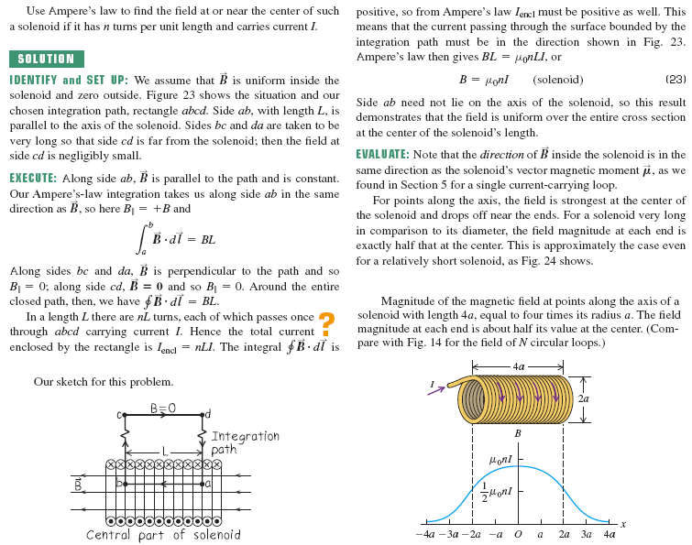

Slide 24
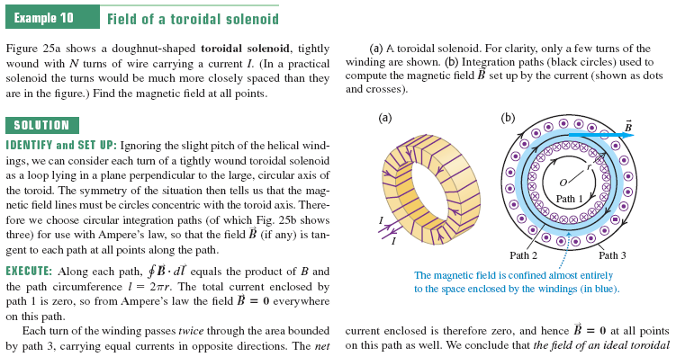

Slide 25
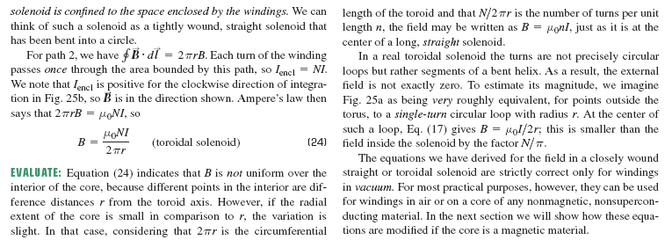

Slide 26
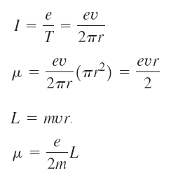
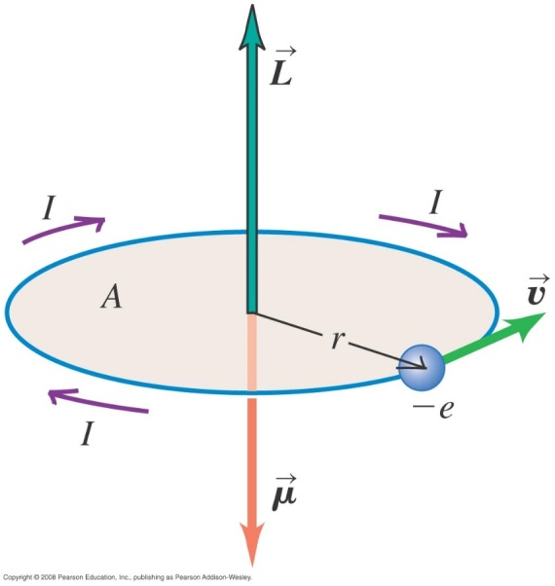
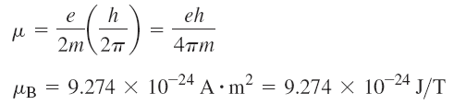
The Bohr magneton
The equivalent current I is the total charge passing any point on the orbit per unit time, which is just the magnitude e of the electron charge divided by the orbital period T:
The Borh magneton:

